Slide 1
CMS Grid Computing at TAMU Performance, Monitoring and Current Status of the Brazos Cluster
Vaikunth Thukral
Department of Physics and Astronomy
Texas A&M University

Slide 2
Outline
Grid Computing with CMS: PhEDEx and CRAB
Our Local Computing center: Brazos/T3_US_TAMU
Performance and Monitoring
Data Transfers
Data Storage
Jobs
Summary

Slide 3
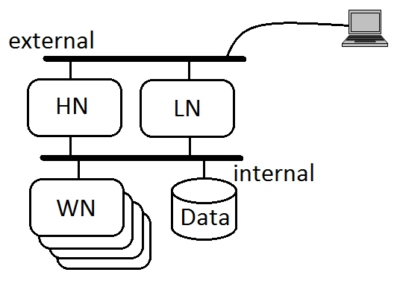
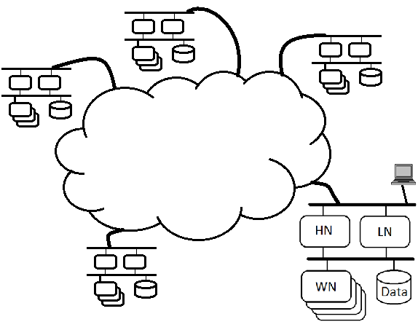
Introduction to Grid Computing
Cluster
Multiple computers in a Local Network
The Grid
Many clusters connected by a Wide Area Network
Resources expanded for thousands of users as they have more access to distributed computing and disk
CMS Grid: Tiered Structure (Mostly about size & location)
Tier 0: CERN
Tier 1: A few National Labs
Tier 2: Bigger University Installations for national use
Tier 3: For local use (Our type of center)

Slide 4
Next: Define PhEDEx and CRAB which are CMS ways of managing data and running “jobs” on the grid
“Jobs” - Breaking up the data analysis into lots of parallel pieces

Slide 5
PhEDEx
Physics Experiment Data Export
Data is spread around the world
Transport tens of Terabytes of data to A&M per month

Slide 6
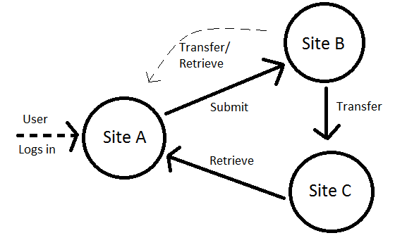
CRAB
CMS Remote Analysis Builder
Jobs are submitted to “the grid” using CRAB
CRAB decides how and where these tasks will run
Same tasks can run anywhere the data is located
Output can be sent anywhere you have permissions

Slide 7
Advantages of Having a CMS Tier 3 Computing Center at TAMU
Don’t have to compete for resources
CPU priority - Even though we only bought a small amount of CPUs, can periodically run on many more CPUs at the cluster at once
Disk space - Can control what data is here
With a “standardized” Tier 3 on a cluster, can run same here as everywhere else
Physicists don’t do System Administration

Slide 8
T3_US_TAMU as part of Brazos
Brazos cluster already established at Texas A&M
Added our own CMS Grid Computing Center within the cluster
Named T3_US_TAMU as per CMS conventions

Slide 9
T3_US_TAMU added CPU and Disk to Brazos as our way of joining
Disk
Brazos has a total of ~150TB of storage space
~30 TB is assigned to our group
Space is shared amongst group members
N.B. Another 20TB in the works
CPU
Brazos has a total of 307 compute nodes/2656 cores
32 nodes/256 cores added by T3_US_TAMU
Since we can run 1 job on each core → 256 jobs at any one time, more when cluster is underutilized, or by prior agreement
184,320 (256 x 24 x 30) dedicated CPU hours/Month

Slide 10
Grid Computing at Brazos Summary
Tier 3 is fully functional on the cluster
Instructions on how to use it can be found at:
http://collider.physics.tamu.edu/tier3/
Updating our "Best Practices" on how to bring over data and run Jobs :
http://collider.physics.tamu.edu/tier3/best_practice

Slide 11
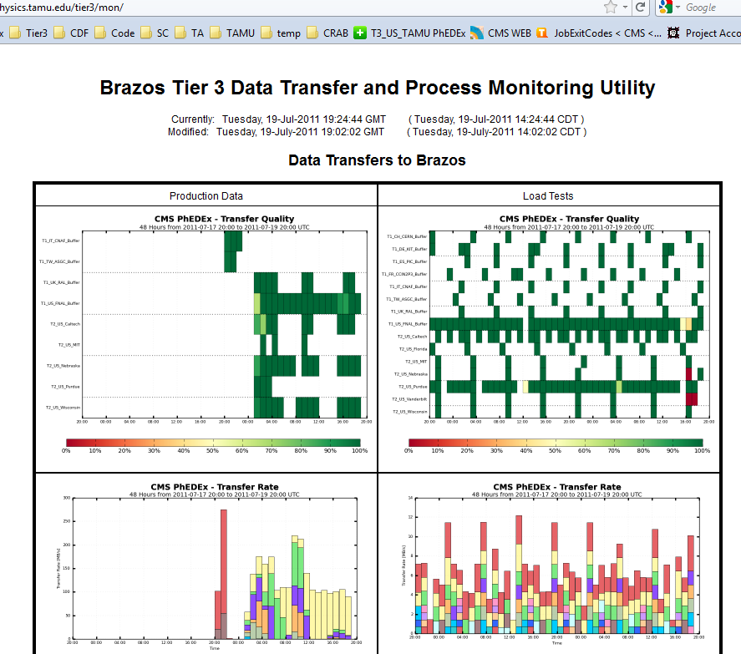
Grid Computing at Brazos Summary
Next: Move to describe how well the system is working by showing results from our Online Monitoring Pages(*)
(*) Thanks to Dr. Joel Walker for leading this effort

Slide 12
Three Main Topics
Tier 3 Functionality
Data Transfers (PhEDEx)
Data Storage: PhEDEx Dataset + Local User Storage
Running Jobs (CRAB)
Need to test and monitor all of these
CMS provides some monitoring tools
We have designed additional Brazos-specific/custom monitoring tools

Slide 13
PhEDEx at Brazos
PhEDEx performance is continually tested in different ways:
LoadTests
Transfer Quality
Transfer Rate

Slide 14
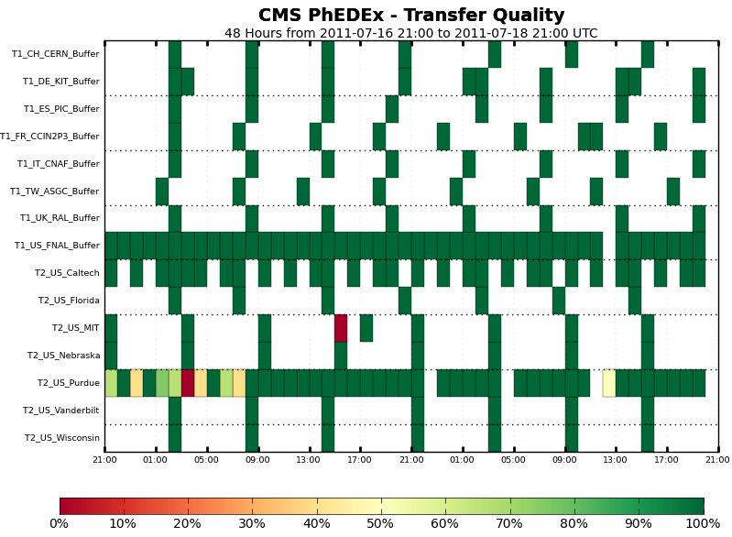
PhEDEx at Brazos (cont.)
LoadTest
Acts as a test of the “handshake” between TAMU and linked sites in Taiwan, Europe, US etc.

Slide 15
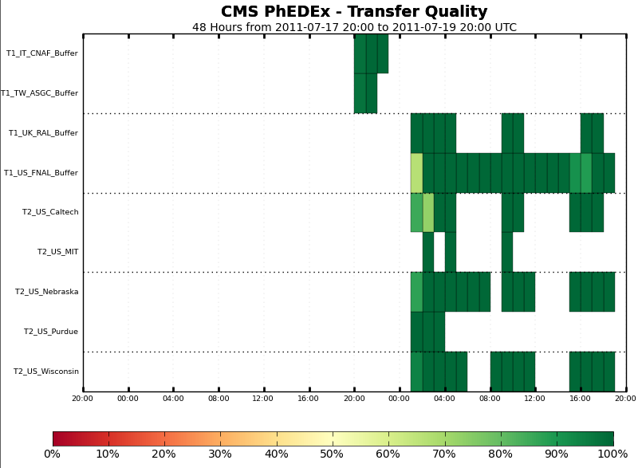
PhEDEx at Brazos (cont.)
Transfer Quality
Monitors whether the transfers we have requested are actually coming across successfully
Transfers from Italy, Taiwan, UK etc.

Slide 16
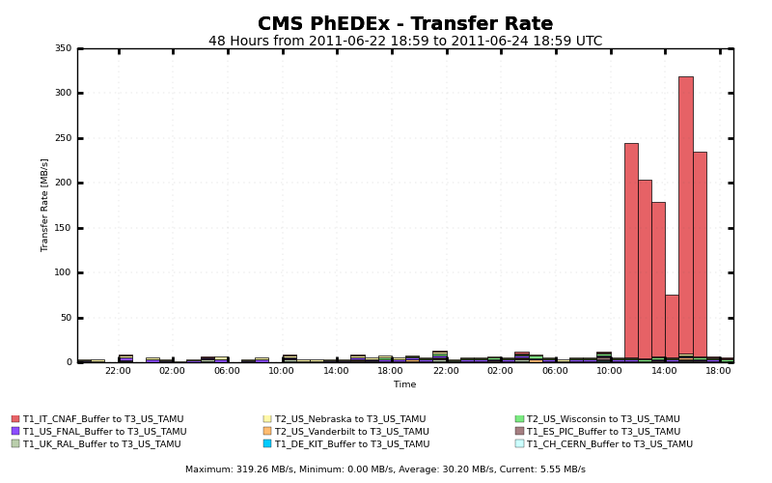
PhEDEx Transfers
PhEDEx Data Transfer Performance (Peak at 320 MB/s)
Network and client settings optimized
20-fold increase in average transfer speeds from January to June
~10 MB/s → ~ 200 MB/s
Other T3 sites average between 50-100 MB/s

Slide 17
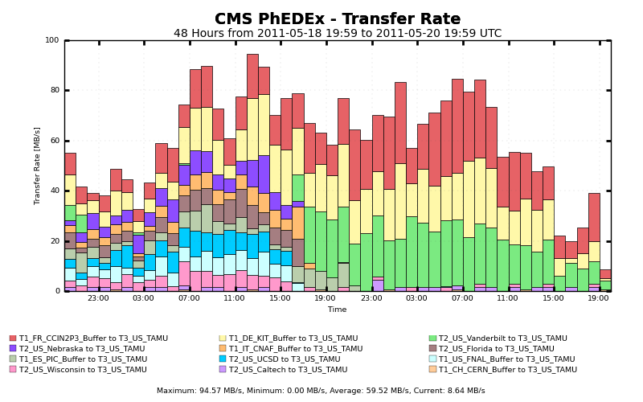
PhEDEx Transfers (cont.)
Can download from multiple locations at once and for extended periods of time
Capable of transferring large volumes consecutively
In principle, could download up to 25 TB in one day!
Have done 10TB just yesterday
Last month we brought over ~45TB

Slide 18
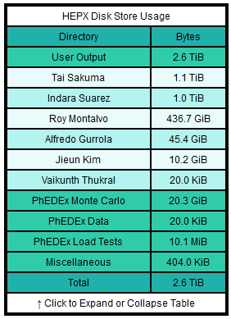
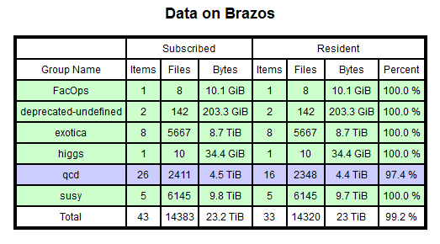
Data Storage and Monitoring
Monitor PhEDEx and User files
HEPX User Output Files
PhEDEx Dataset Usage
Note that this is important for self-imposed quotas. Need to know if we are keeping below our 30TB allocation. Will expand to 50TB soon. Will eventually be sending email if we get near our limit.

Slide 19
Running CRAB jobs on BRAZOS
Have set up two fully functional ways for the convenience of users
condor_g – run jobs locally
gLite - can submit from anywhere in the world!
More as needed
PBS - in the process of making this work
Have created standard test jobs
CRAB Admin Test Suite (CATS?) - These test both condor_g and gLite, output to FNAL and Brazos, big and small outputs, as well as large numbers of jobs.

Slide 20
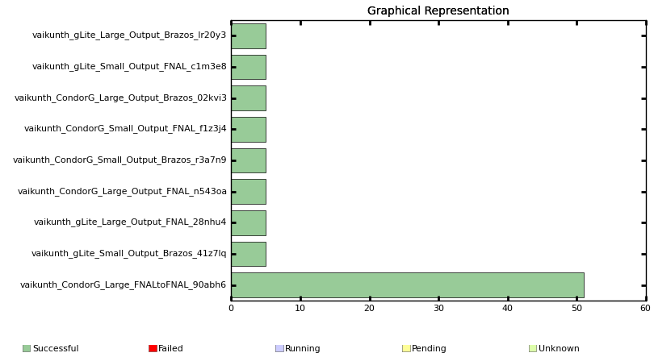
Current Status of CATS
Validation test jobs (CATS) – All work
Working on automating these to run periodically → Then add to monitoring site

Slide 21
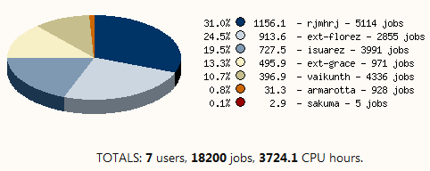
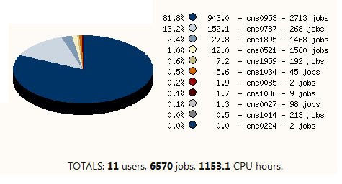
Already running LOTS of CRAB Jobs
CRAB Usage by different groups
The A&M group has used a large amount of CPU
Fraction Hours
← HEPX group usage in June
Fraction Hours
Not all CPU available to use has been used by members of the Aggie Family →
We have provided a lot of CPU to outside users on CMS

Slide 22
More on CPU used and Jobs Run
CRAB Performance
Job success rates have improved
Larger number of use-cases accommodates more jobs
Current trend indicates exponential usage, and we can still use MANY more CPU hours

Slide 23
Future Plans and Upgrades for Brazos/Monitoring
Add ability to run jobs via PBS
Add more monitoring of jobs and CPU
Add more disk
Automate the running of CATS regularly, report results on Monitoring page
Automate the checking of the monitoring to send mail on a failure or critical condition (disk space nearly fully, jobs failing, PhEDEx transfers failing, etc.)

Slide 24
Summary
Grid Computing is a central part of CMS Analysis around the world
Our own Grid Computing Center gives us high priority access to disk space and CPU which is an important competitive advantage in the search for Supersymmetry and the Higgs
T3_US_TAMU at Brazos is fully functional and has already provided useful resources to the group
We are constantly working to improve the monitoring of the system
More resources will be added as we max out current ones

Slide 25
BACKUP SLIDES

Slide 26
Resources
Future expansion
Adding 20 TB more to current disk space
Can continue to get more as needs increase
Possibly upgrade to a Tier 2 site
The Brazos Team

Slide 27
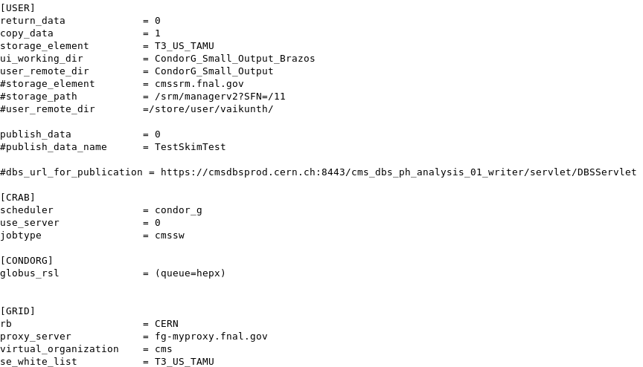
Operation Procedures
Submitting jobs at T3_US_TAMU
Many use cases tested extensively
Some cases work better than others
Best way to run tasks on Brazos: http://collider.physics.tamu.edu/tier3/best_practice
An Example

Slide 28
Operation Procedures
Important Configuration Parameters
Schedulers
Datasets
White Lists
Scheduler Options at T3_US_TAMU
Condor_g – Quick, suited for local submissions
gLite – Slower, suited for grid submissions
PBS – Currently being tested

Slide 29
Optimization
Testing CRAB
Construct test jobs
These jobs test every aspect of the process
Currently run 8 test jobs
Particular cases tested:
Scheduler type
Output file size (Small/Large)
Local output destination
Remote output destination
Number of jobs (Small/Large)

Slide 30
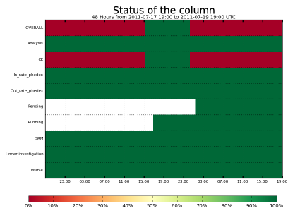
Monitoring
Tools Provided by the Grid
SAM tests
PhEDEx webpage

